Slide 1
Rosemary’s Copier with Advance Wireless Print Technology
Github Link: https://github.com/HoaPCS/BUS5021
SAP Link:
https://higher-education.us10.sapanalytics.cloud/sap/fpa/ui/tenants/81639/bo/story/6E840B837DEA0F00B1E6FE38A7620A3C
Data Source:
https://community.tableau.com/s/question/0D54T00000CWeX8SAL/sample-superstore-sales-excelxls
Author: Teresa Hernandez Ramos, Rosemary Mosquera, Long Zhang, Hoa Pham
California State University Los Angeles BUS5100-93
Introduction To Business Analytics

Slide 2

Introduction
Identify emerging opportunities for our flagship project "Rosemary's Copier with Advance wireless print technology" across various channels determining the optimal launchpad for our startup through strategic locations
Analyzing data trends to forecast future marker directions.
Using SAP's geolocation tools, our analysis focuses on locations that present more projectable trends through time series analysis, regression and exponential smoothing that tests for precise risks in creating our products.

Slide 3
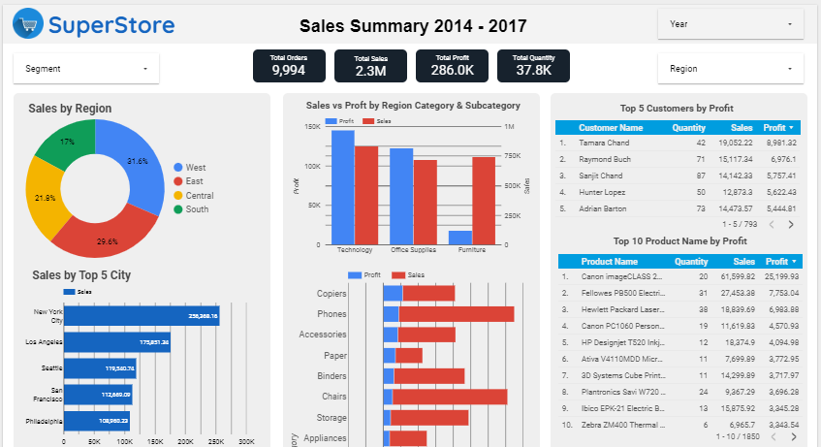
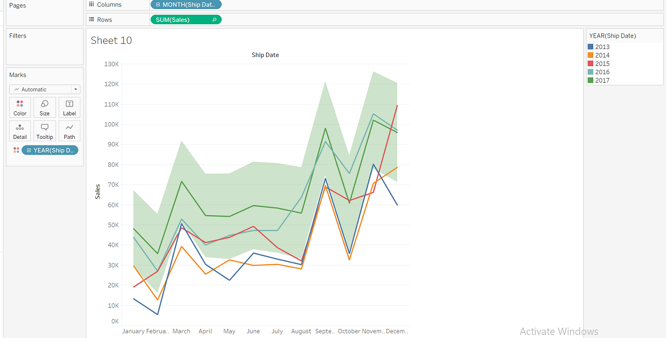
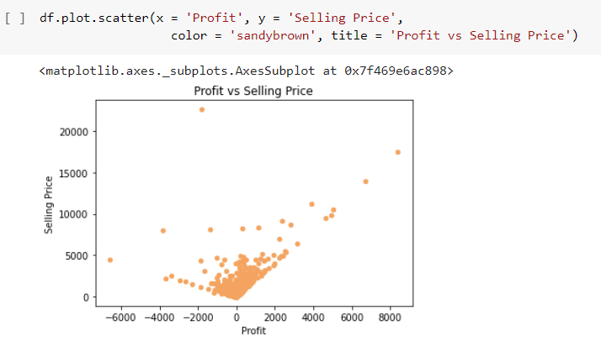
Related Work
How data from superstores has been widely utilized in the community.
Explore the common strategies employed by publications to present insights:
Visualization Techniques:
❏Bubble Charts
❏Bar Charts
❏Stacked Columns
❏Scatter Charts

Slide 4

Comparative Study of Two Notable Publications
Mreza’s study focused on sales and trends in superstores during the specified period.
Key Findings:
Trend analysis based on item categories.
Visualization methods used: Pie Charts and Sales Bar Charts.
Identified top-performing categories and items.
Our Approach:
Projectable Trends:
Utilizing time series analysis, regression, and exponential smoothing.
Assessing precise risks for product creation.

Slide 5
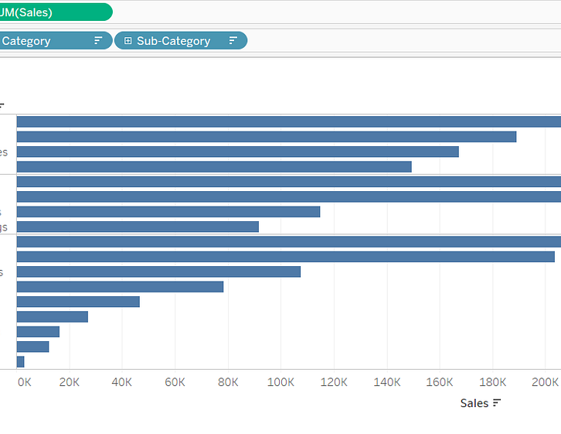
Swasti Khurana’s Insights (Future Trends)
Swasti Khurana’s work also explored sales trend analysis.
Unique Aspect:
Projectable Trends for the Future:
Analyzing upcoming trends.
Our Additional Focus:
State-Level Profitability:
Identifying which states yield the highest profits.
Strategic targeting based on profitability.

Slide 6
File Specification
Data Set | Size: Total 3.2 MGB
Orders | 3.19 MGB
Returns | 13.7 KB
People | 8.63 KB
Fundamental for driving into sales trends
Understanding customer preference, evaluating product performance and offering solid foundation for data analytics
Size ensures a comprehensive research of business intelligence concepts

Slide 7
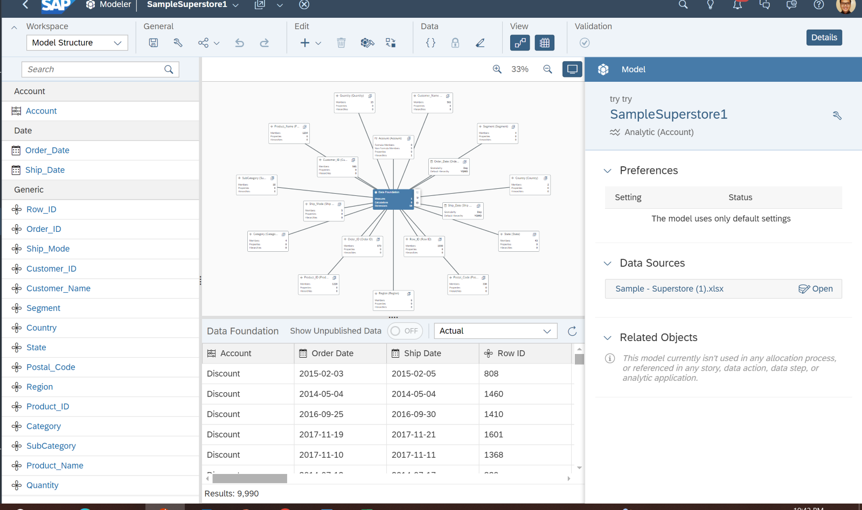
Data Cleaning
Customer
Geocoding
Generate longitude and latitude for each
customer base.
Hierarchy
Customer Location.
Product hierarchy.

Slide 8
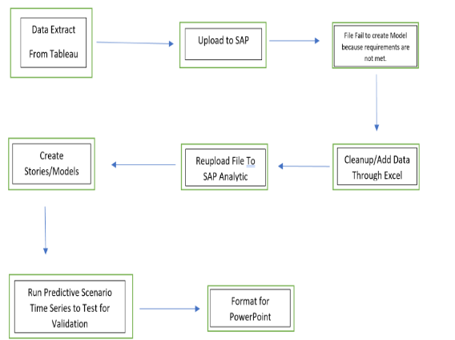
Implementation flow chart
CSV files required reorganization and the addition of a few critical elements
Preparatory step was essential to ensure the data was compatible with SAP requirements
Fully leverage the analytical capabilities of the platform
Models then transitioned into a power point

Slide 9
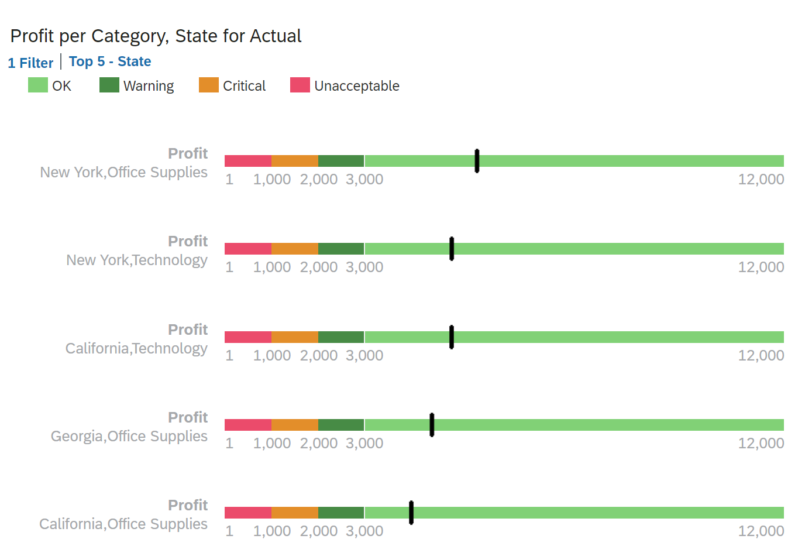
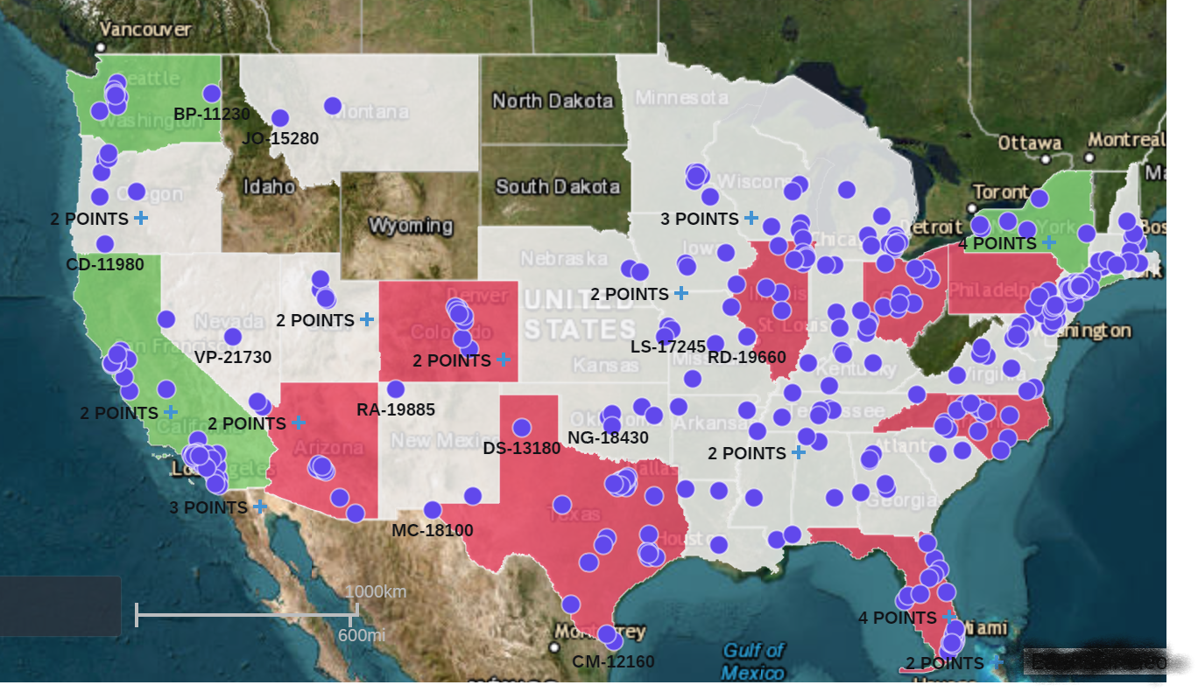
Focus States
Highly Profitable States
Washington, California, and New York.
Significant sales and market growth potential identified.
Neutral Opportunity for Expansion
Georgia identified as a steady opportunity state.
Presents less pronounced but stable potential for expansion.
Strategic Benefits
Enables effective allocation of resources.
Tailors marketing strategies to regions with highest returns

Slide 10
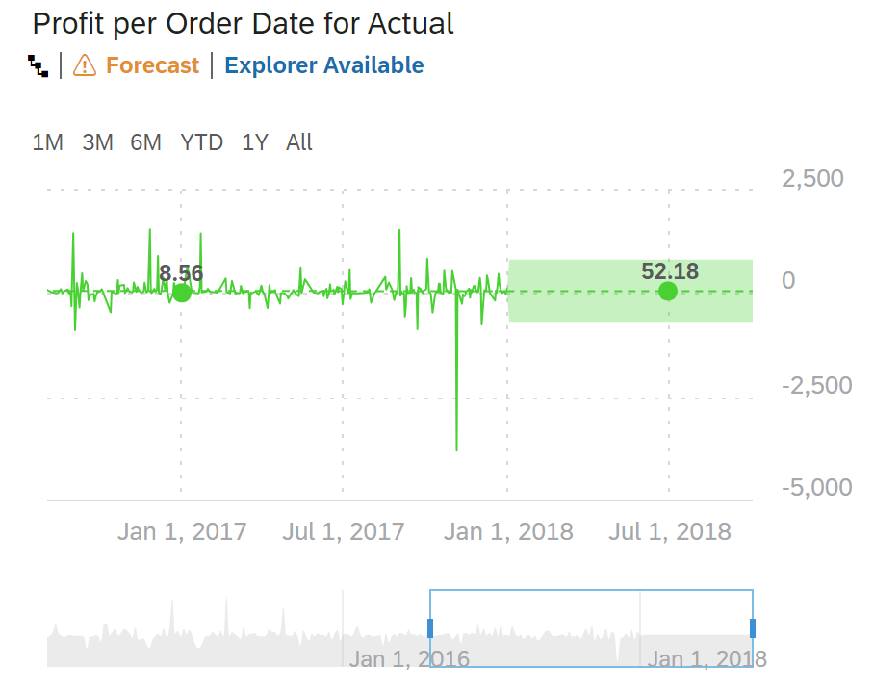
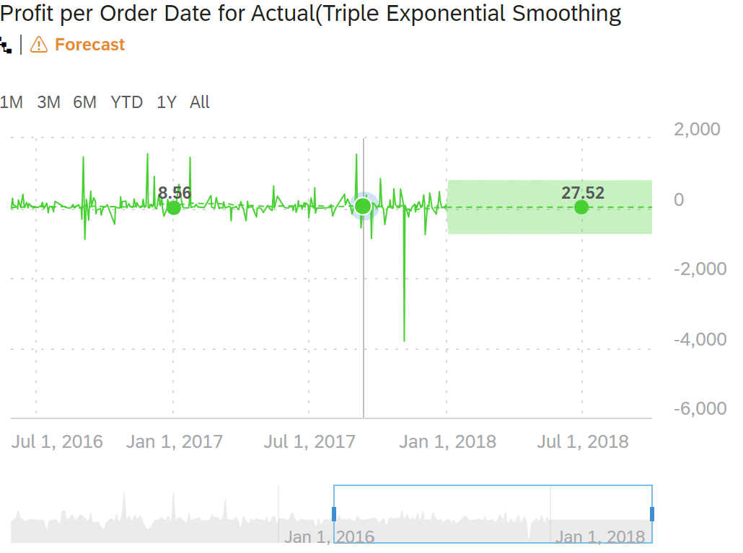
Profit Forecast Summary
Linear Regression Insights
Predicts steady profit growth; forecast at $52.18.
Suggests increased profitability for super stores.
Triple Exponential Smoothing Insights
Highlights seasonal trends; conservative forecast at $27.52.
Offers nuanced risk management, preferred for cautious strategies.
Forecast Comparison
Linear regression predicts 47.25% higher profits than triple smoothing.
Choice of model affects strategy and risk tolerance.

Slide 11
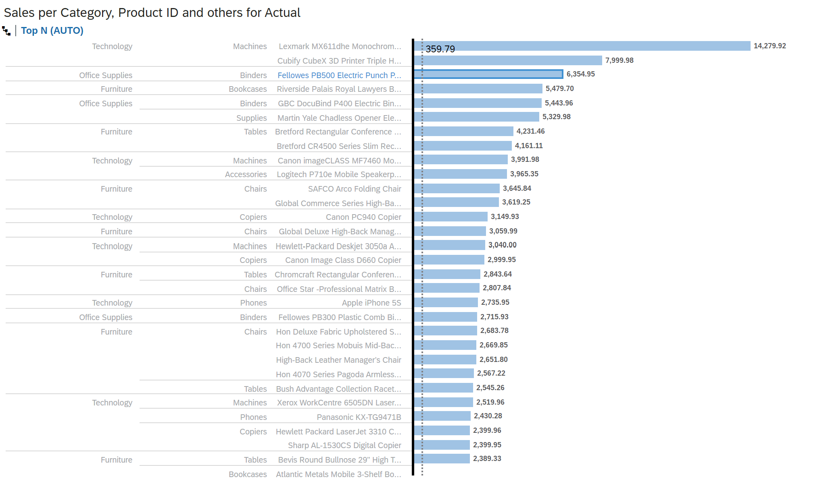
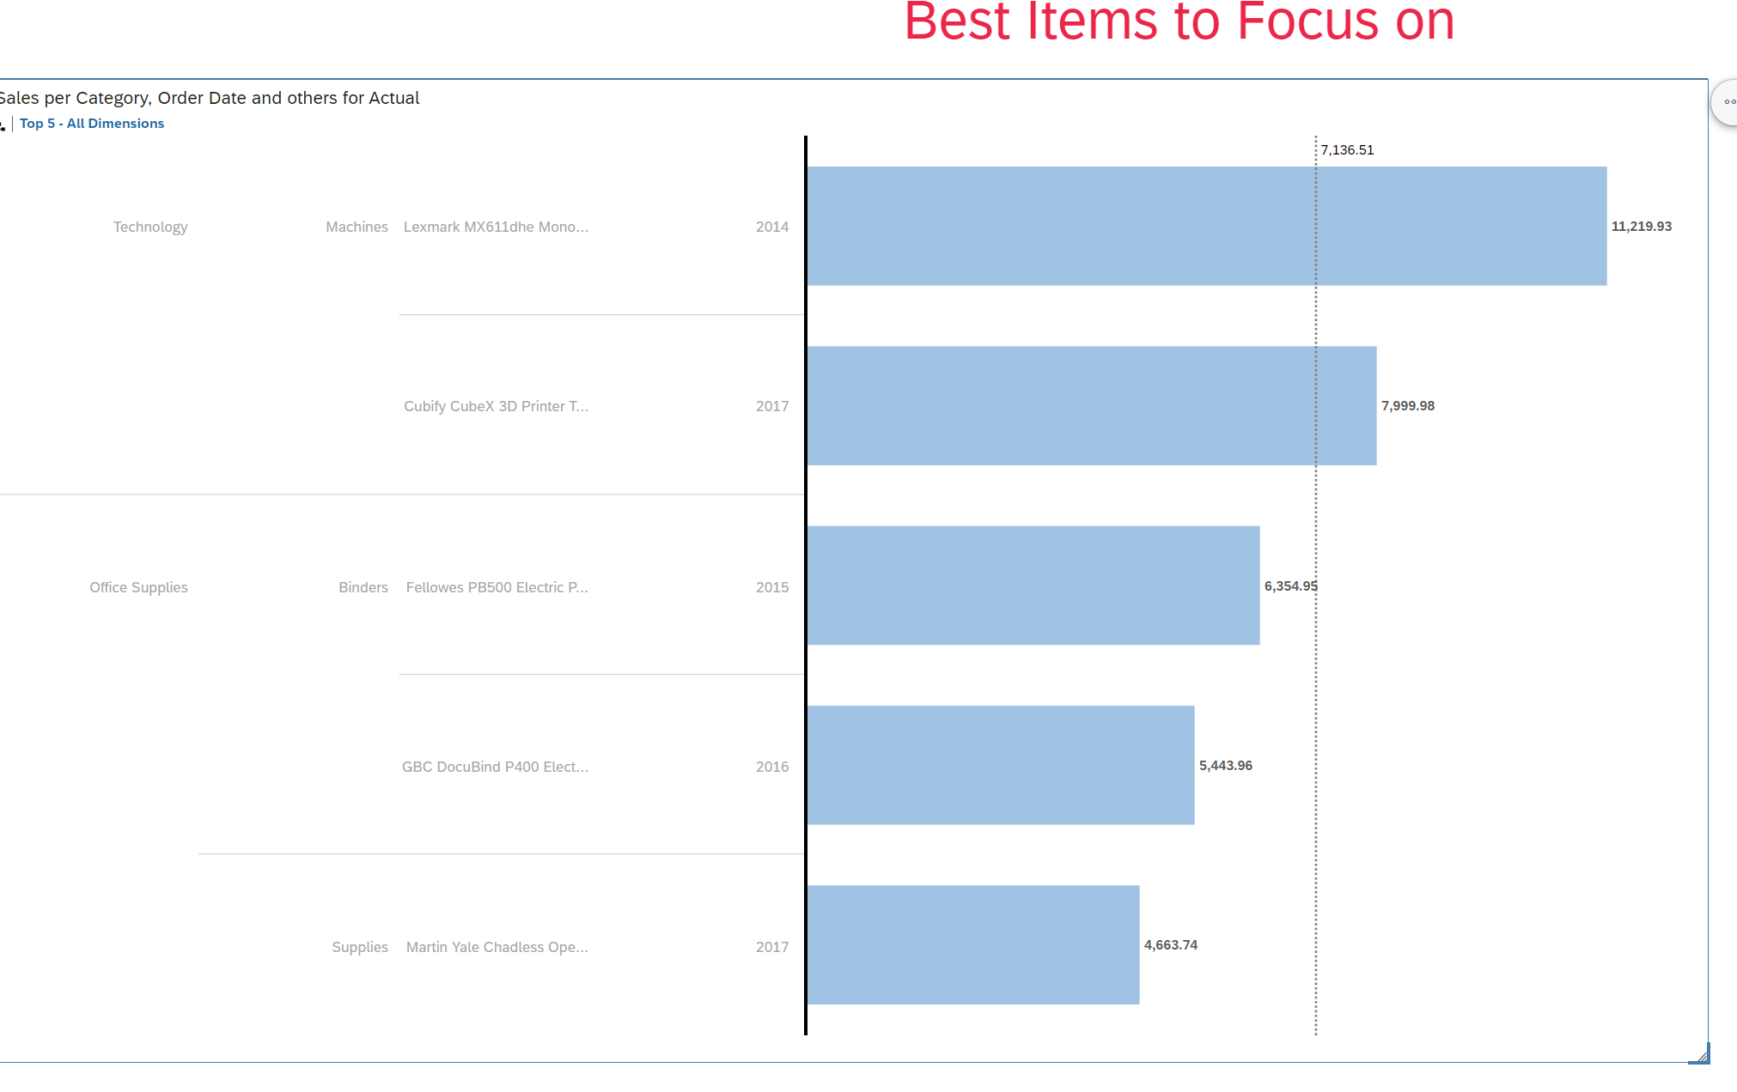
Sales Analysis by Category
Importance of Category Analysis
Essential for identifying top trending categories and products.
Key Findings
Printers/Copiers are among top sub-categories throughout all of the super stores in the United States.
Strategic Implications
Trends inform inventory and marketing focus.
Prioritize resources towards trending categories for optimal sales growth.

Slide 12
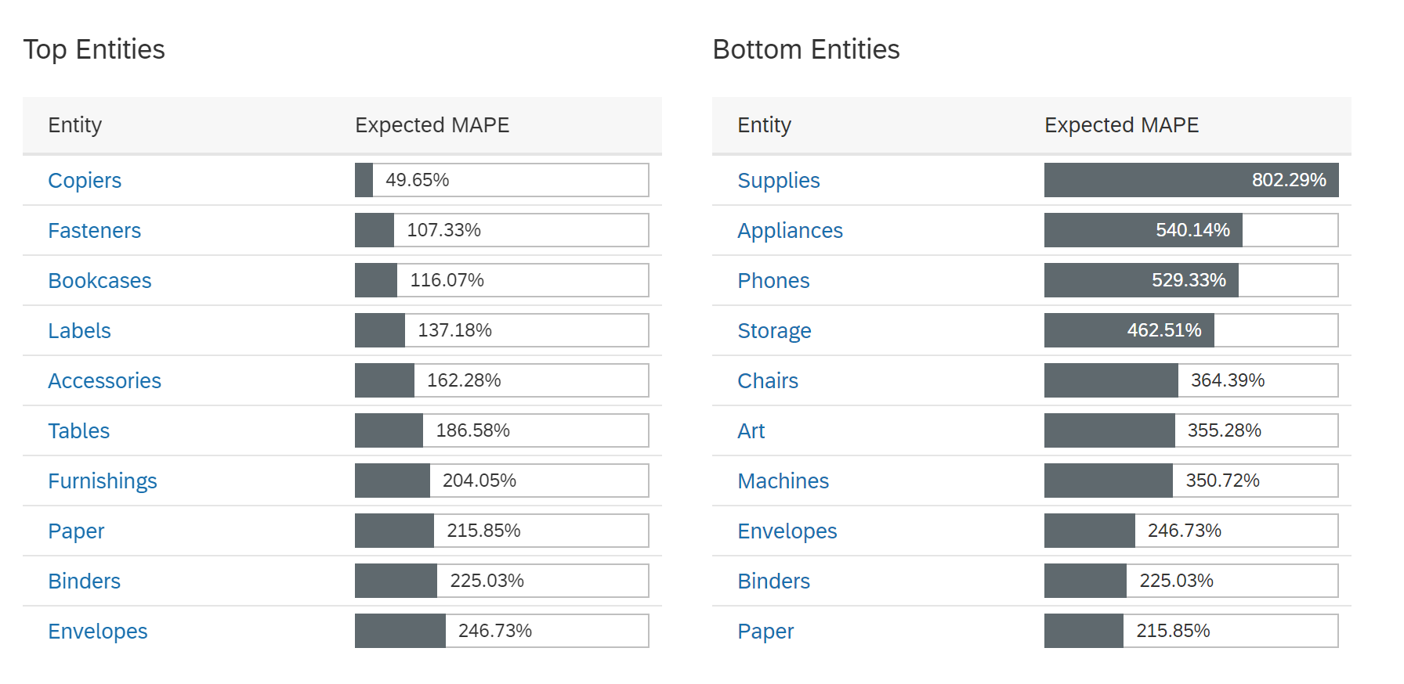
Predictive Analysis using Time Series(Mean Absolute Percentage Error)
Key Indicator: MAPE
Mean Absolute Percentage Error (MAPE) critical for analysis accuracy.
Copiers stand out with a MAPE under 50%.
High MAPE Concerns
Categories with MAPE > 100% require closer examination.
High MAPE signifies lower prediction accuracy.
Category Analysis
Most categories exhibit MAPE > 100%, indicating potential for misdirected focus.
High MAPE values suggest unprofitability in these categories.
Accuracy Highlights
Copiers show highest accuracy with 49.65% MAPE.
Fasteners and Bookcases have MAPEs of 107.33% and 116.07%, respectively.
MAPE > 20% generally deemed inaccurate, yet Copiers provide a notable exception.

Slide 13
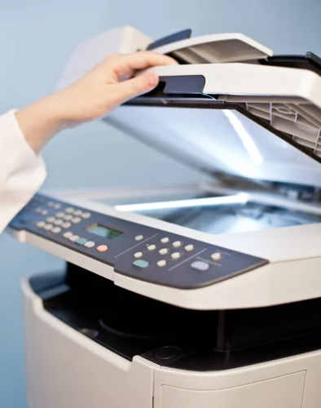
Conclusion
Throughout the analysis for the creation of "Rosemary's Copier with Advance wireless print technology," we can conclude:
The product should only be sold in Washington State, New York, California and expand to Georgia after a successful campaign
Even though stores have massive inventory on products, choosing a copier machine with printing functionality might be the best bet as data is leaning towards these two categories.
Launch date would have to be around October, as sales are starting to accelerate from October until March.

